Slide 1
Intel Unnati Industrial Training Program 2024 Report
Intel Unnati Internship Report by Rukaiyya Abdul Hamid Qureshi
III Year, B.Tech Artificial Intelligence and Data Science,
Faculty of Engineering and Technology, DMIHER (DU),
Sawangi (m), Wardha, Maharashtra
Mentor- MS. SHITAL HAJARE

Slide 2
Problem Statement
The problem statement assigned to me was based on “Introduction to GenAI and Simple LLM Inference on CPU and finetuning of LLM Model to create a Custom Chatbot”, were I was able to built a chatbot on Intel Dev Cloud and also Fine tuned it.
My project addressed:
Implementing simple LLM inference on CPU
Fine-tuning an LLM model to create a custom chatbot
Overcoming the challenges of working with large pre-trained models
Applying my understanding of machine learning and Python programming to GenAI

Slide 3
Unique Idea Brief
To address these challenges, I developed a hands-on approach that allowed me to gain practical experience.
My solution involved:
Thoroughly researching Gen AI concepts and LLM architectures
Implementing LLM inference on my CPU-only setup
Developing a step-by-step process for fine-tuning pre-trained LLMs
Creating a custom chatbot using Intel AI Tools
This approach allowed me to gain valuable insights into the entire GenAI development process.

Slide 4
Features Offered
Throughout my project, I successfully implemented the following features:
CPU-based LLM inference using optimized libraries
Fine-tuning of a pre-trained LLM for my specific use case
A custom chatbot capable of answering queries about Intel products along with the required datasets.
Performance optimization techniques to improve inference speed on CPU
A simple web interface for interacting with my chatbot
These features collectively demonstrated my ability to apply GenAI concepts in a practical, real-world scenario.

Slide 5
Process flow
I followed a systematic process to complete my project:
I began by deeply studying Gen AI concepts and LLM architectures, and its applications.
Next, I set up my development environment, installing necessary libraries and configuring Intel AI Tools on my system.
I then implemented LLM inference on my CPU, optimizing it for better performance using techniques I learned from Intel's documentation.
Using the fine-tuned model, I developed a custom chatbot capable of answering queries about Intel products.
Finally, I rigorously tested the chatbot, identifying and fixing issues, and further optimizing its performance.

Slide 6
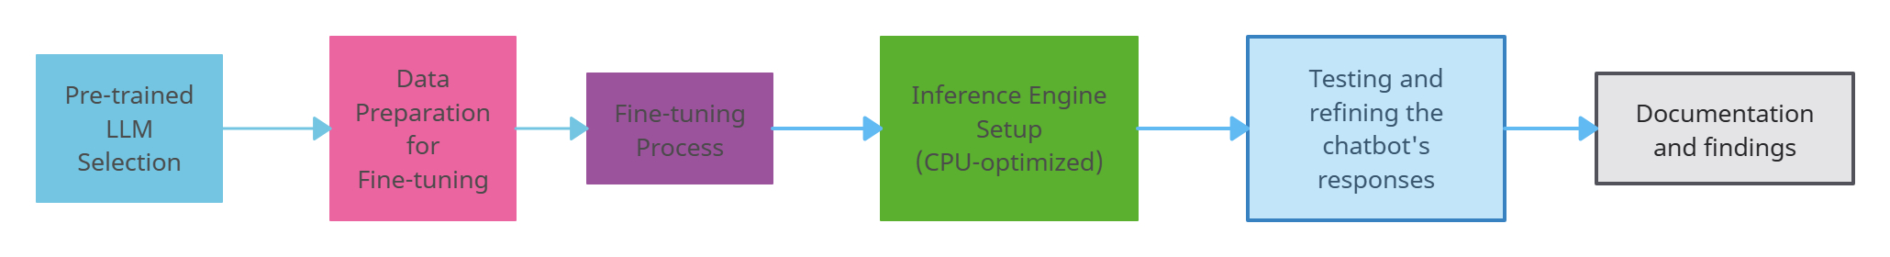
Architecture Diagram
Fig. Architecture Diagram for LLMs
This architecture illustrates the end-to-end process of developing a custom chatbot using fine-tuned LLMs.

Slide 7
Technologies used
In my project, I utilized the following technologies:
Python for all programming tasks
Hugging Face Transformers
TensorFlow for model training and inference
Intel® Distribution of OpenVINO™ toolkit for CPU optimization
Jupyter Notebooks for experimentation and documentation
This tech stack allowed me to efficiently develop and optimize my GenAI application.

Slide 8
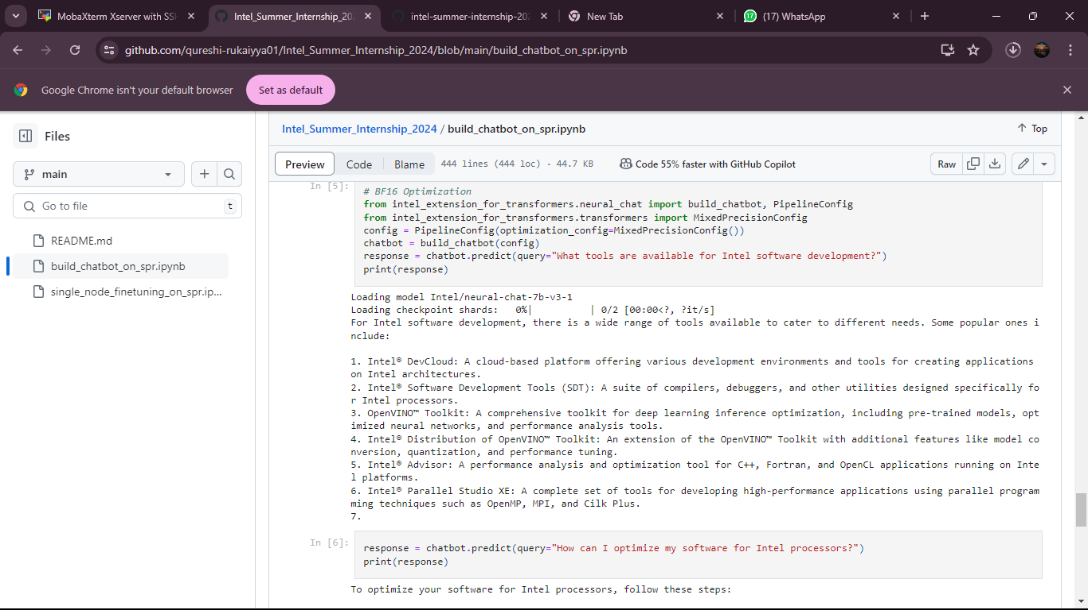
LLM Inferences in Action

Slide 9
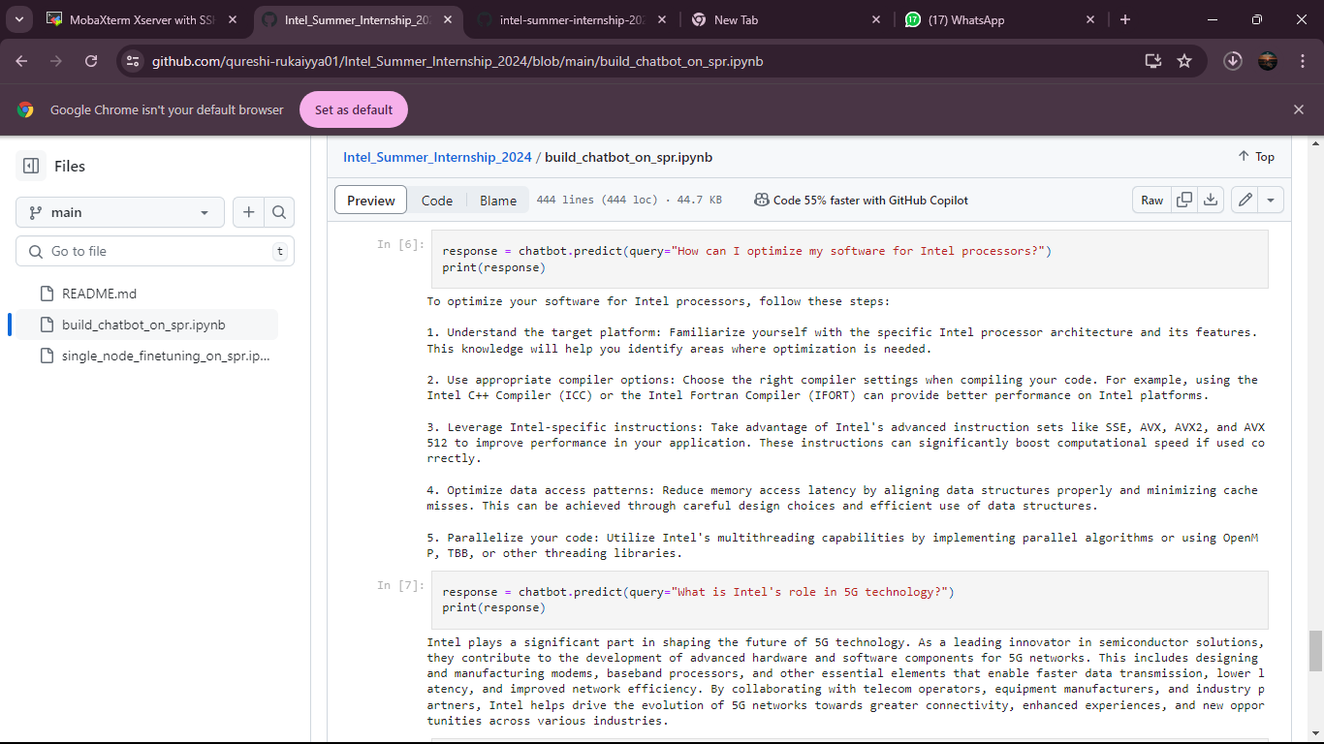
LLM Inferences in Action

Slide 10
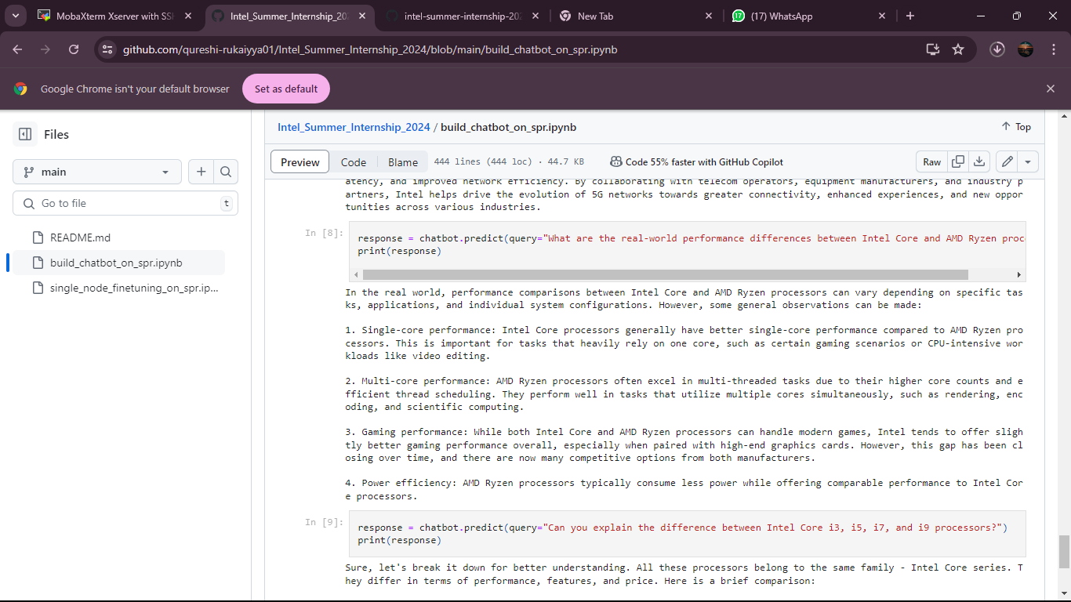
LLM Inferences in Action

Slide 11
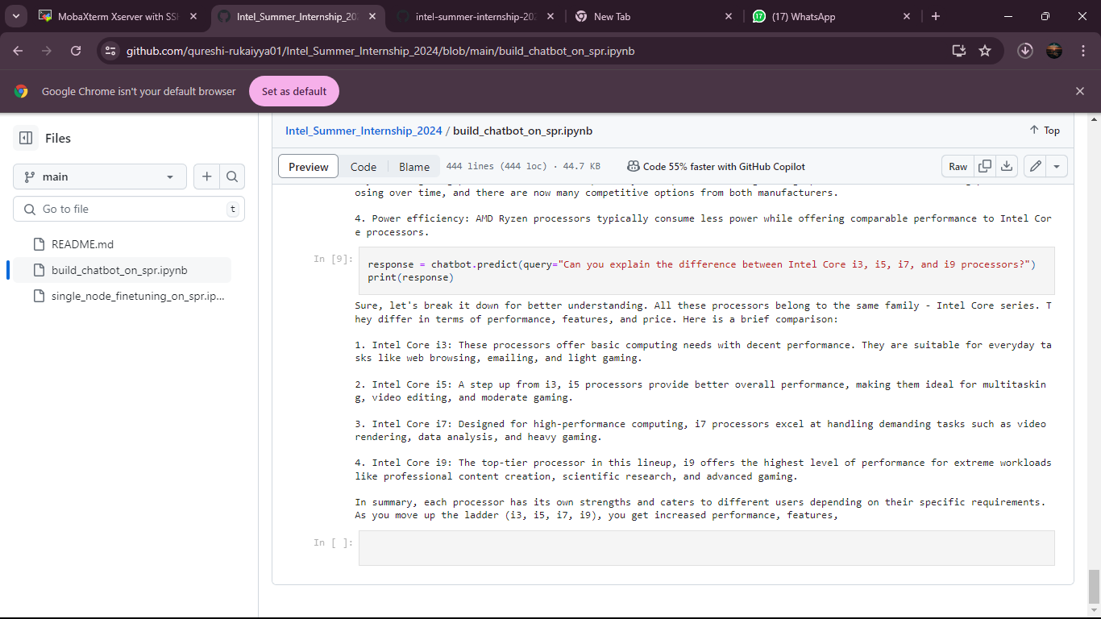
LLM Inferences in Action

Slide 12
Team members and contribution
As an individual project, I was responsible for all aspects of development:
Researching Gen AI and LLM concepts
Implementing and optimizing LLM inference on CPU
Testing and refining the chatbot's responses
Documenting my process and findings

Slide 13
Conclusion
Through this Intel Unnati Industrial Training Program 2024, I gained invaluable hands-on experience in the field of Generative AI and Large Language Models. I successfully overcame the challenge of working with resource-intensive models on a CPU-only setup, demonstrating that meaningful AI development is possible even without specialized hardware.
Key achievements include:
Implementing efficient CPU-based LLM inference
Successfully fine-tuning chatbot
Gaining proficiency in using Intel AI Tools for optimized AI development
This project has solidified my interest in AI and provided me with a strong foundation for future work in this field. The skills I've gained in model fine-tuning, optimization, and practical AI application development will be invaluable as I continue my academic and professional journey in computer science and AI.

